Slide 1
Object Oriented Programming I: Lecture 3
Ahmed Imteaj
Lecturer
Dept. of CSE, IIUC

Slide 2
Relation between Classes
The three main types of relationships between classes are generalization (inheritance), aggregation, and association.
Generalization - This implies an "is a" relationship. One class is derived from another, the base class. Generalization is implemented as inheritance in C++. The derived class has more specialization. It may either override the methods of the base, or add new methods. Examples are a poodle class derived from a dog class.

Slide 3
Relation between Classes
Aggregation - This implies a "has a" relationship. One class is constructed from other classes, that is, it contains objects of any component classes. For example, a car class would contain objects such as tires, doors, engine, and seats.
Association - Two or more classes interact in some manner. They may extract information from each other, or update each other in some way. As an example, a car class may need to interact with a road class, or if you live near any metropolitan area, the car class may need to pay a toll collector class.

Slide 4
Structures and Unions
Structures are used to group together different data elements (types of variables) under the same name. These data elements, known as members, can have different types and different lengths.
Take look at the syntax of a structure:
struct structure_name
{
type member_name1;
type member_name2;
} object_names;

Slide 5
Structures and Unions
#include<iostream>
using namespace std;
struct telephone
{
char *name;
int number;
};
int main()
{ struct telephone index;
index.name = "Jane Monroe";
index.number = 12345;
cout << "Name: " << index.name << '\n';
cout << "Telephone number: " << index.number;
return 0; }

Slide 6
Structures and Unions
A union is like a structure in which all members are stored at the same address.
Members of a union can only be accessed one at a time. The union data type was invented to prevent memory fragmentation.
The union data type prevents fragmentation by creating a standard size for certain data.
Just like with structures, the members of unions can be accessed with the . and -> operators. Take a look at the example:
#include<iostream>
using namespace std;
typedef union myunion
{ double PI;
int B; }
MYUNION;
int main()
{ MYUNION numbers;
numbers.PI = 3.14;
numbers.B = 50;
return 0; }

Slide 7
Static Data Members
When you precede a member variable's declaration with static, you are telling the compiler that only one copy of that variable will exist and that all objects of the class will share that variable.
Unlike regular data members, individual copies of a static member variable are not made for each object. No matter how many objects of a class are created, only one copy of a static data member exists. Thus, all objects of that class use that same variable.
All static variables are initialized to zero before the first object is created.

Slide 8
Static Data Members
When you declare a static data member within a class, you are not defining it. (That is, you are not allocating storage for it.)
Instead, you must provide a global definition for it elsewhere, outside the class.
This is done by redeclaring the static variable using the scope resolution operator to identify the class to which it belongs. This causes storage for the variable to be allocated.

Slide 9
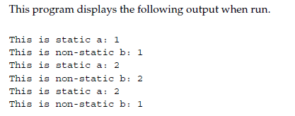
Static Data Members
int main()
{
shared x, y;
x.set(1, 1); // set a to 1
x.show();
y.set(2, 2); // change a to 2
y.show();
x.show();
return 0;
}
#include <iostream>
using namespace std;
class shared {
static int a;
int b;
public:
void set(int i, int j) {a=i; b=j;}
void show();
} ;
int shared::a; // define a
void shared::show()
{
cout << "This is static a: " << a;
cout << "\nThis is non-static b: " << b;
cout << "\n";
}

Slide 10
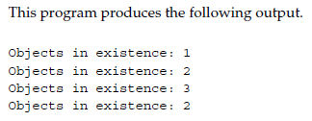
Static Data Members
#include <iostream>
using namespace std;
class Counter {
public:
static int count;
Counter() { count++; }
~Counter() { count--; }
};
int Counter::count;
void f()
{
Counter temp;
cout << "Objects in existence: ";
cout << Counter::count << "\n";
// temp is destroyed when f() returns
}
int main()
{
Counter o1;
cout << "Objects in existence: ";
cout << Counter::count << "\n";
Counter o2;
cout << "Objects in existence: ";
cout << Counter::count << "\n";
f();
cout << "Objects in existence: ";
cout << Counter::count << "\n";
return 0;
}

Slide 11
Static Member Functions
Member functions may also be declared as static.
They may only directly refer to other static members of the class.
A static member function does not have a this pointer.
There cannot be a static and a non-static version of the same function.

Slide 12
Static Member Functions
Actually, static member functions have limited applications, but one good use for them is to "preinitialize" private static data before any object is actually created. For example, this is a perfectly valid C++ program:
#include <iostream>
using namespace std;
class static_type {
static int i;
public:
static void init(int x) {i = x;}
void show() {cout << i;}
};
int static_type::i; // define i
int main()
{
// init static data before object creation
static_type::init(100);
static_type x;
x.show(); // displays 100
return 0;
}
Output:
100

Slide 13
Using new and delete
C++ provides two dynamic allocation operators: new and delete. These operators are used to allocate and free memory at run time.
The new operator allocates memory and returns a pointer to the start of it.
The delete operator frees memory previously allocated using new. The general forms of new and delete are shown here:
p_var = new type;
delete p_var;
Here, p_var is a pointer variable that receives a pointer to memory that is large enough to hold an item of type type.

Slide 14
Using new and delete
#include <iostream>
#include <new>
using namespace std;
int main()
{
int *p;
try {
p = new int; // initialize to 87
} catch (bad_alloc xa) {
cout << "Allocation Failure\n";
return 1;
}
*p = 100;
cout << "At " << p << " ";
cout << "is the value " << *p << "\n";
delete p;
return 0;
}

Slide 15
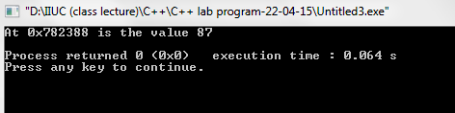
Using new and delete (Initializing Allocated Memory)
#include <iostream>
#include <new>
using namespace std;
int main()
{
int *p;
try {
p = new int (87); // initialize to 87
} catch (bad_alloc xa) {
cout << "Allocation Failure\n";
return 1;
}
cout << "At " << p << " ";
cout << "is the value " << *p << "\n";
delete p;
return 0;
}

Slide 16
Using new and delete (Allocating Arrays)
You can allocate arrays using new by using this general form:
p_var = new array_type [size];
Here, size specifies the number of elements in the array.
To free an array, use this form of delete:
delete [ ] p_var;
Here, the [ ] informs delete that an array is being released.
For example, the next program allocates a 10-element integer array.

Slide 17
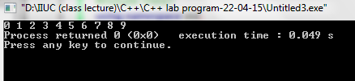
Using new and delete (Allocating Arrays)
#include <iostream>
#include <new>
using namespace std;
int main()
{
int *p, i;
try {
p = new int [10]; // allocate 10 integer array
} catch (bad_alloc xa) {
cout << "Allocation Failure\n";
return 1;
}
for(i=0; i<10; i++ )
p[i] = i;
for(i=0; i<10; i++)
cout << p[i] << " ";
delete [] p; // release the array
return 0;
}

Slide 18
Thank You!!

